Slide 1
H1B Visa Status DATS 6401 Visualization of Complex data professor : Reza Jafari
Presented by:
Sagar Tripathi

Slide 2
Today’s Discussion
Introduction
Description of Dataset
Pre-Processing of Data
Packages
Graphs
PCA
Summary and conclusion
References

Slide 3
Introduction
The Immigration and Nationality Act's section 101(a)(15)(H) authorizes U.S. firms to temporarily hire foreign workers in specialist occupations. This visa is known as the H-1B. A bachelor's degree or the equivalent in work experience is required for a specialty career in addition to the application of specialized knowledge.
Link of Dataset: https://www.kaggle.com/datasets/jmpark746/h1b-visas?select=h1b18.csv

Slide 4
Description of Dataset
Data from the employer's Labor Condition Application and case certification findings handled by the Office of Foreign Labor Certification are included in the H-1B Dataset chosen for this research (OFLC). In order to hire non-immigrant workers at a specific job occupation in an area of intended employment for a period of not longer than three years, a prospective H-1B employer must submit a Labor Condition Application (LCA) to the U.S. Department of Labor Employment and Training Administration (DOLETA).
The columns of this dataset are Used: 'CASE_STATUS','month_CASE_SUBMITTED','month_Decision','EMPLOYMENT_END_DATE','month_EMPLOYMENT_End' ,'CASE_SUBMITTED', 'DECISION_DATE', 'VISA_CLASS’,'EMPLOYMENT_START_DATE’, 'EMPLOYMENT_END_DATE', 'EMPLOYER_NAME’, 'EMPLOYER_STATE', 'JOB_TITLE', 'FULL_TIME_POSITION', 'PREVAILING_WAGE’, 'PW_UNIT_OF_PAY', 'WAGE_RATE_OF_PAY_FROM’, 'SOC_CODE’, 'EMPLOYMENT_END_DATE', 'SOC_NAME', 'CASE_NUMBER', 'EMPLOYER_POSTAL_CODE', 'EMPLOYER_CITY', 'WAGE_RATE_OF_PAY_TO', 'WAGE_UNIT_OF_PAY’
Link of Dataset: https://www.kaggle.com/datasets/jmpark746/h1b-visas?select=h1b18.csv

Slide 5
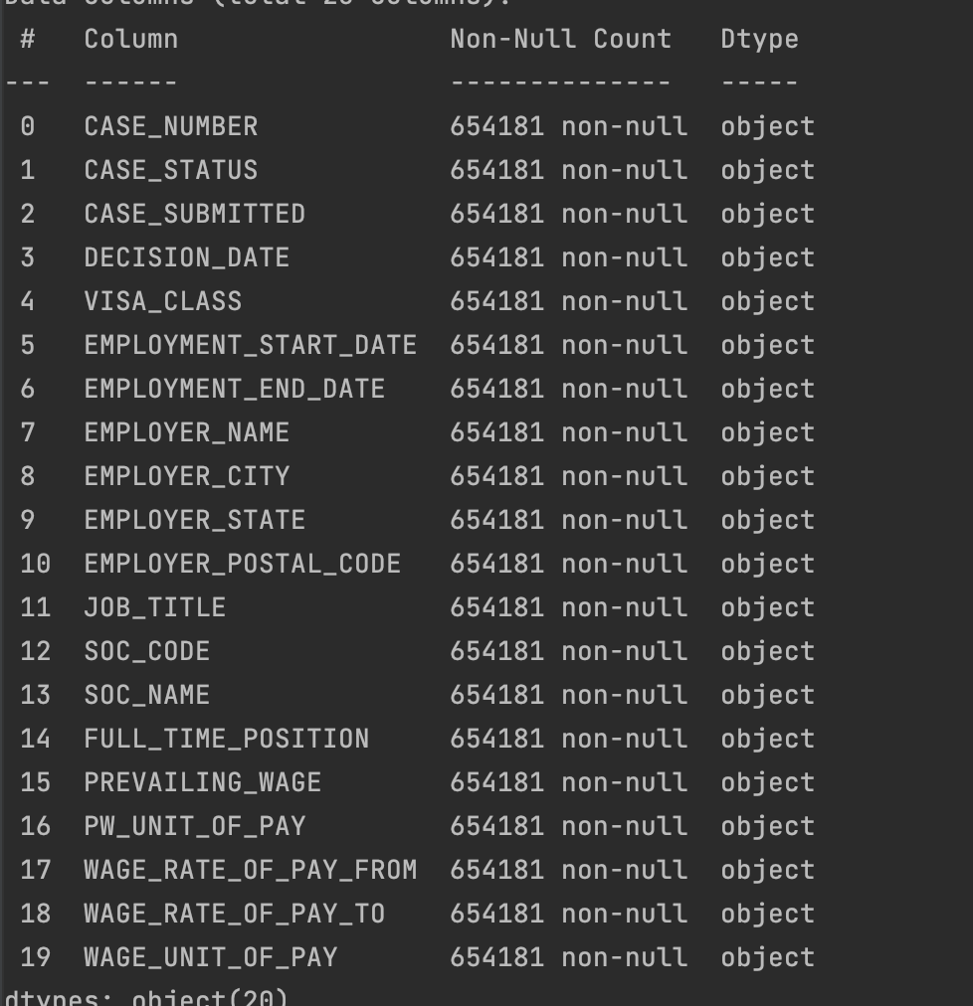
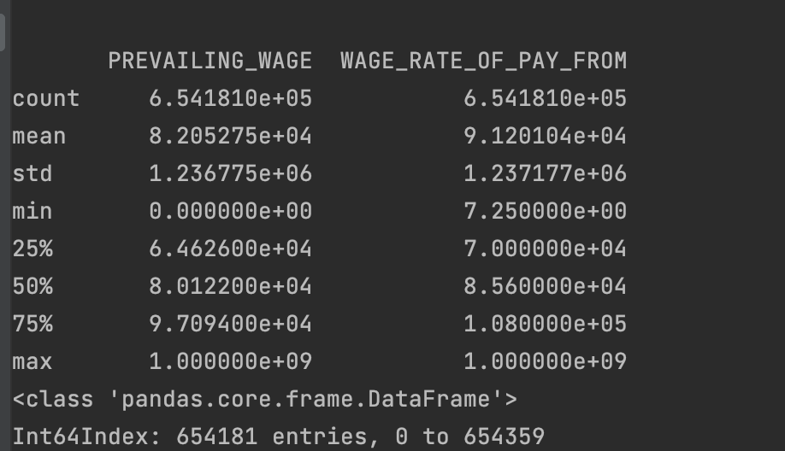
Dataset Information & Description:

Slide 6
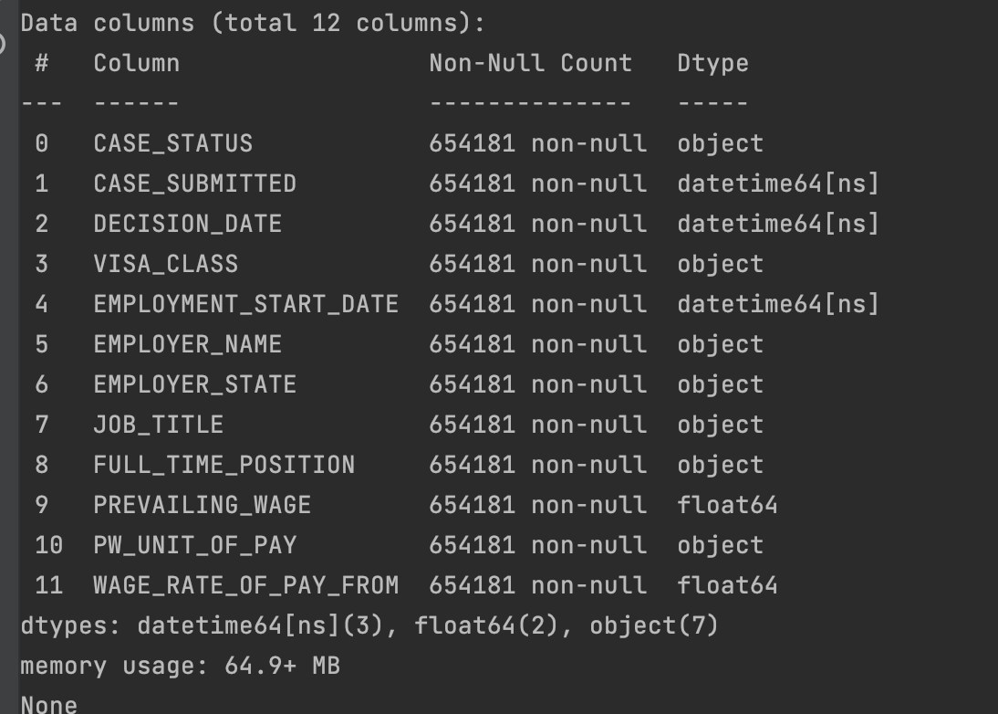
Final Dataset:

Slide 7
Pre-processing
Loading the Data
Checking missing values
Handling Identifiers
Finding outliers via box plot
Feature Selection

Slide 8
Major Packages
Dash: Dash apps significantly broaden the notion of what is achievable in a standard "dashboard" by providing a point-and-click interface to models written in Python. Data scientists and engineers give business operators access to sophisticated Python analytics through Dash apps.
Plotly: Plotly offers scientific graphing libraries for Python, R, MATLAB, Perl, Julia, Arduino, and REST as well as online graphing, analytics, and statistics capabilities for individuals and groups.

Slide 9
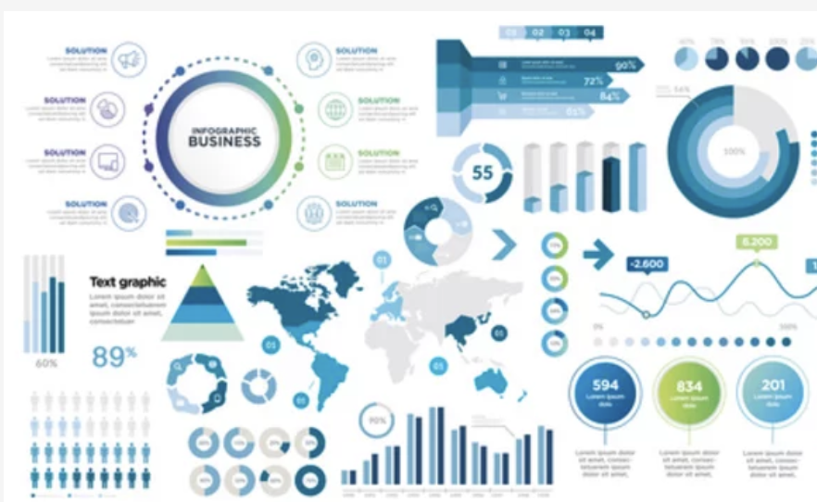
Insights from Graphs
Histogram
Scatterplot
Pie Chart
Line chart
count plot
heat map
Bar plot
Pair plot
Box plot

Slide 10
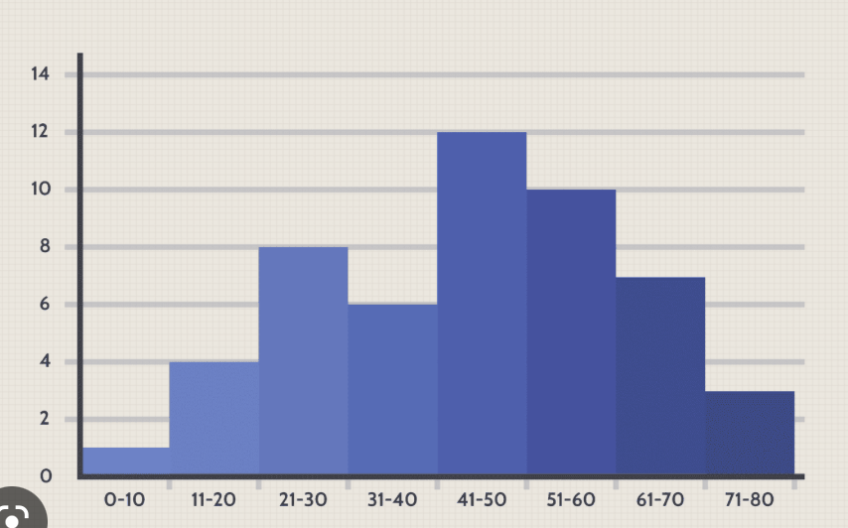
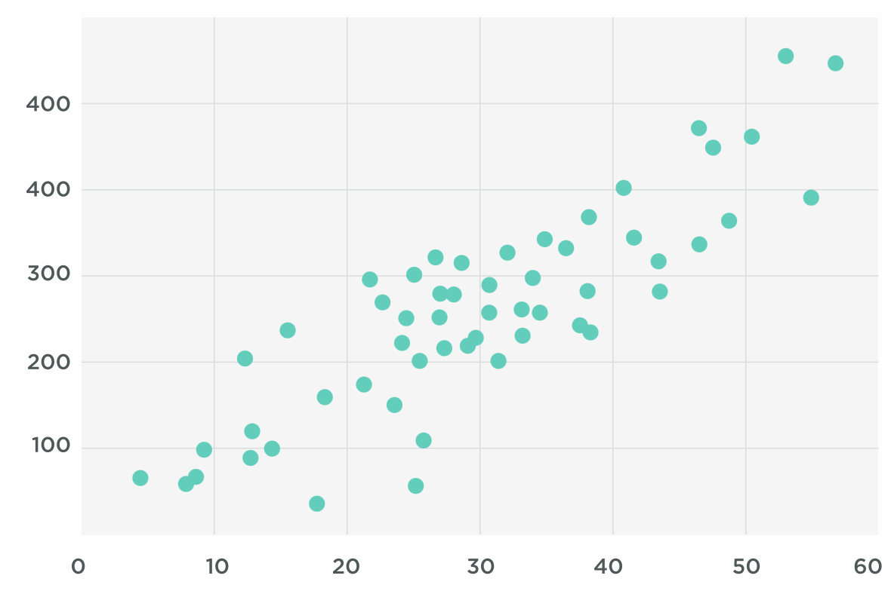
Histogram:
A histogram is a plot that lets you discover, and show,
the underlying requency distribution (shape) of a set
of continuous data.
Scatter Plot:
A scatter chart, also called a scatter plot, is a chart that shows
the relationship between two variables. They are an incredibly
powerful chart type, allowing viewers to immediately understand
a relationship or trend, which would be impossible to see in
almost any other form.

Slide 11
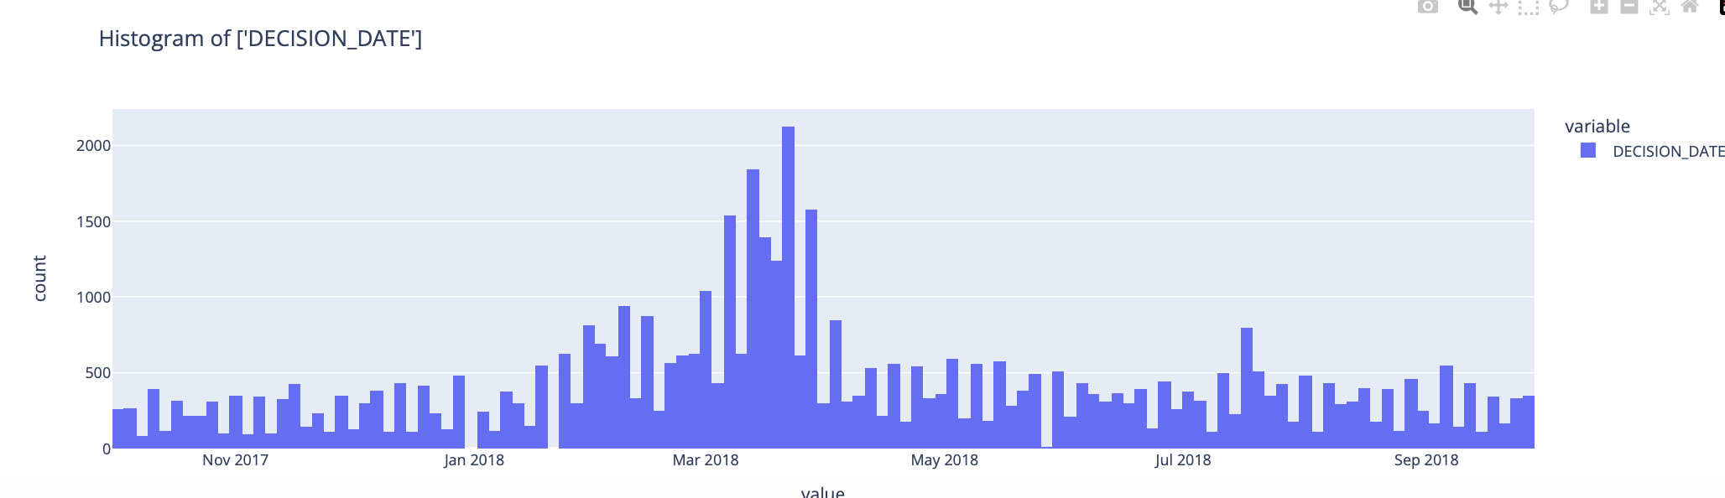
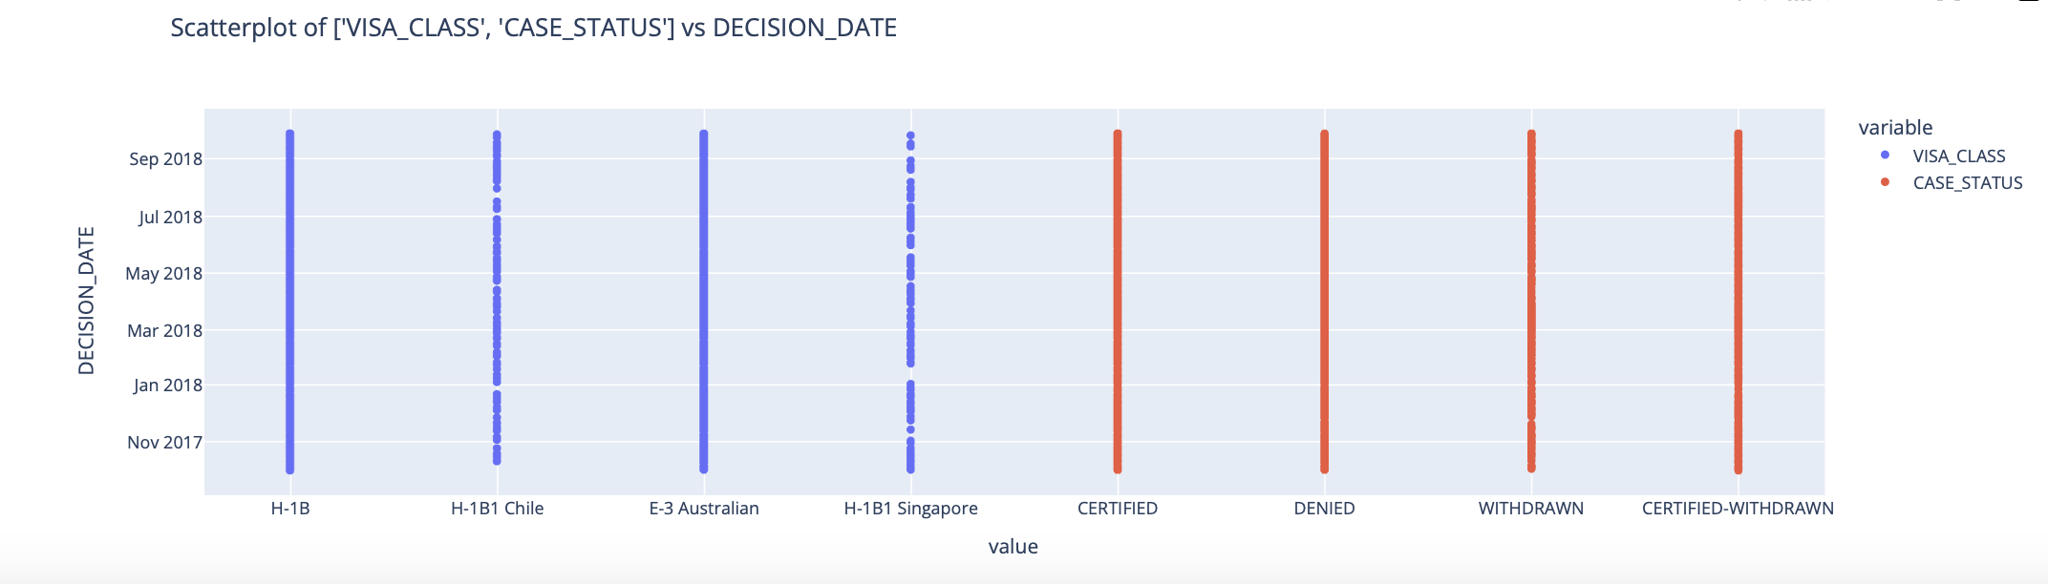
Histogram & Scatter Plot

Slide 12
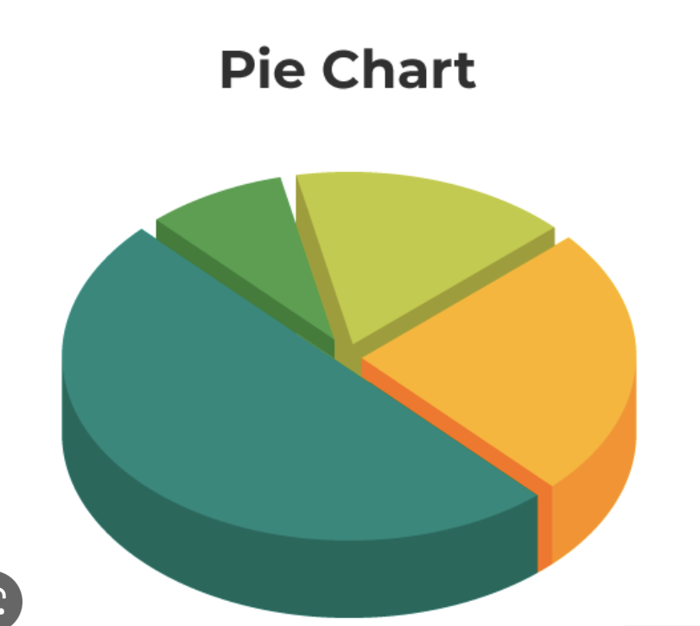
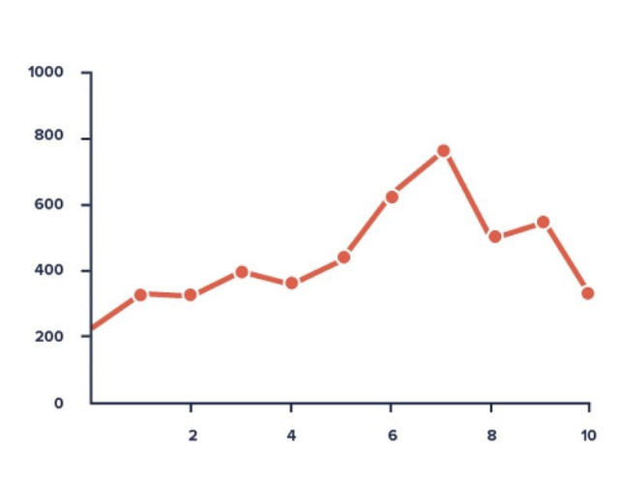
Pie Chart:
A pie chart is a graphical representation technique that displays data in a circular-shaped graph. It is a composite static chart that works best with few variables. Pie charts are often used to represent sample data—with data points belonging to a combination of different categories.
Line chart:
A line chart, also referred to as a line graph or a line plot, connects
a series of data points using a line. This chart type presents sequential
values to help you identify trends. Most of the time, the x-axis
(horizontal axis) represents a sequential progression of values.

Slide 13
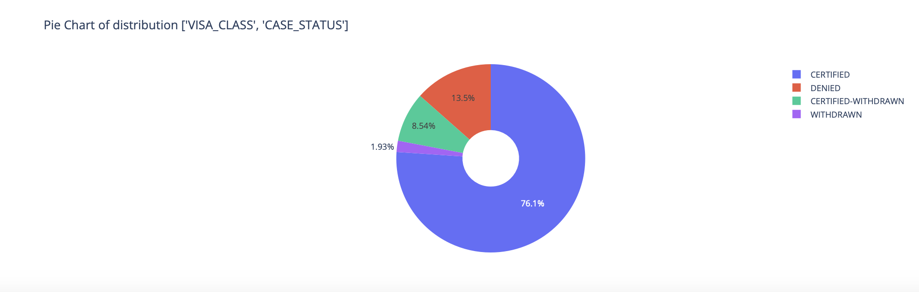
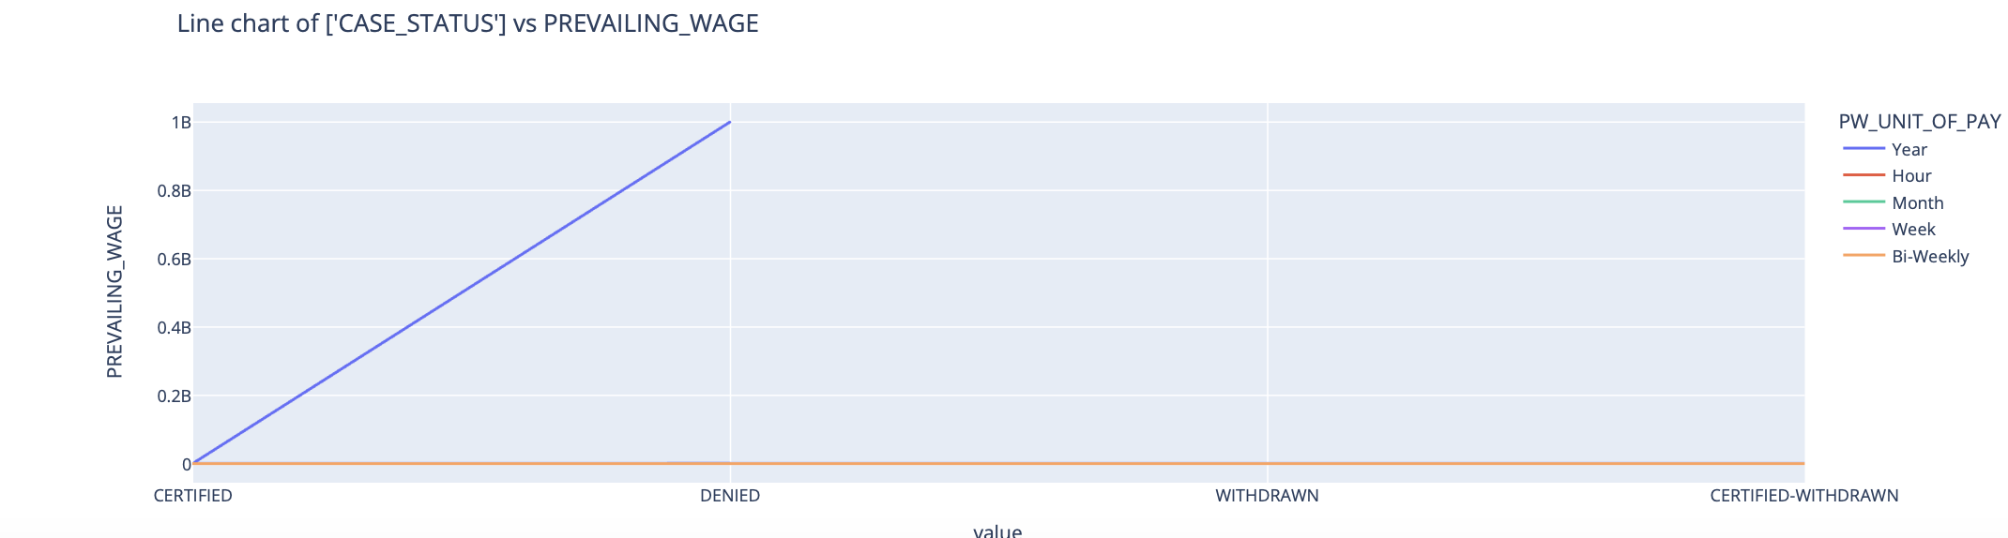
Pie Chart & Line plot

Slide 14
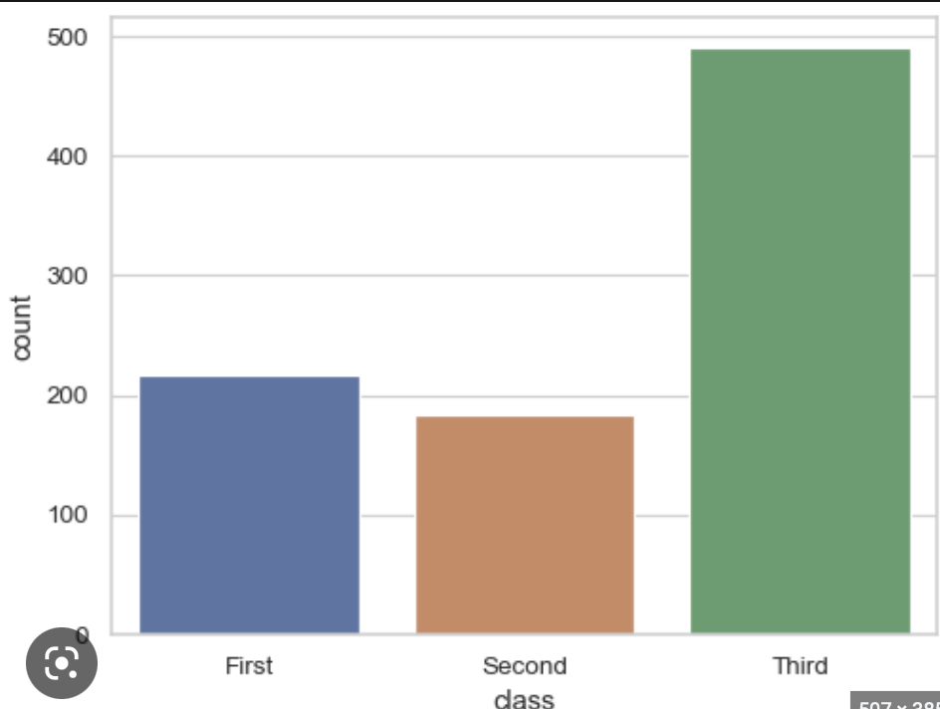
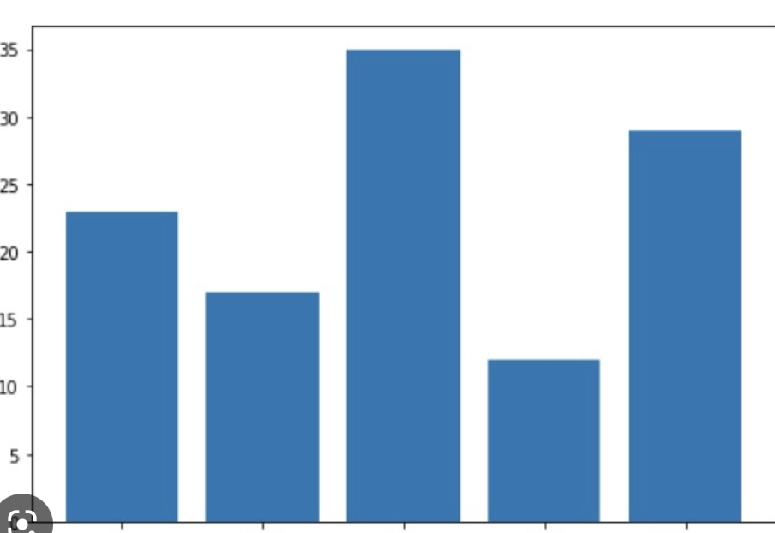
Count Plot:
The count plot is used to represent the occurrence(counts)
of the observation present in the categorical variable
Bar Plot :
A bar plot or bar chart is a graph that represents the category
of data with rectangular bars with lengths and heights that is
proportional to the values which they represent. The bar plots
can be plotted horizontally or vertically. A bar chart describes
the comparisons between the discrete categories.

Slide 15
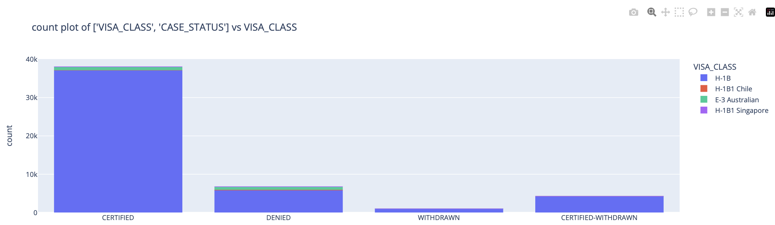
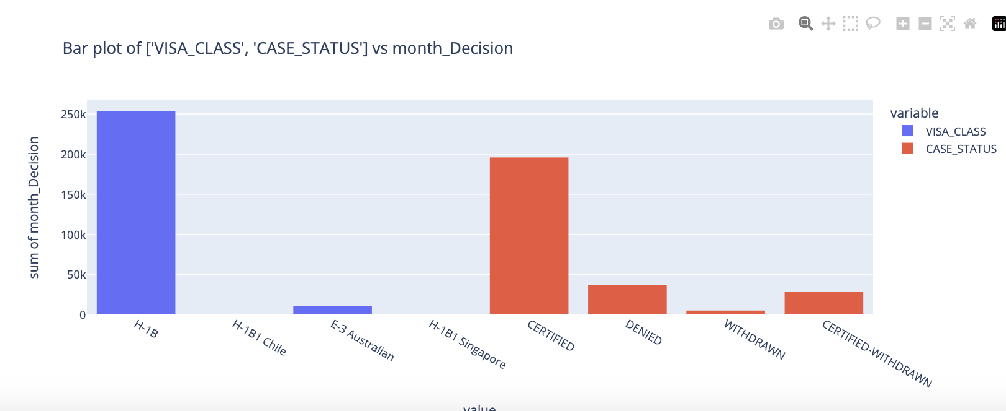
Count Plot & Bar plot

Slide 16
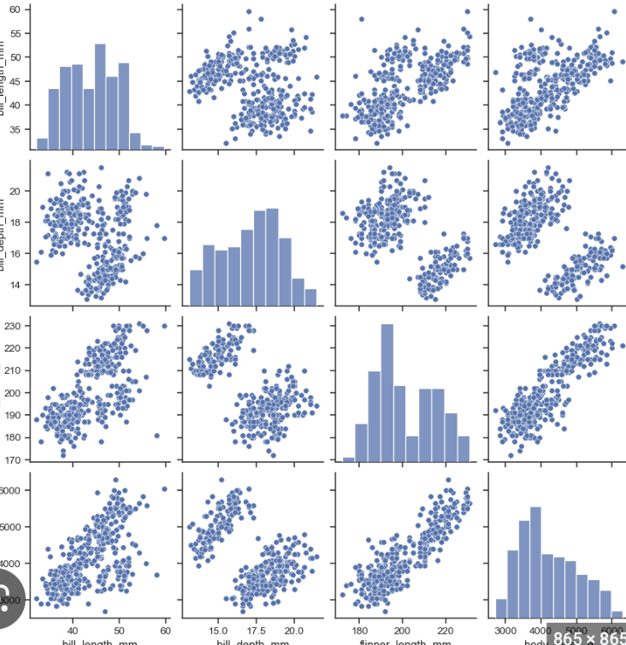
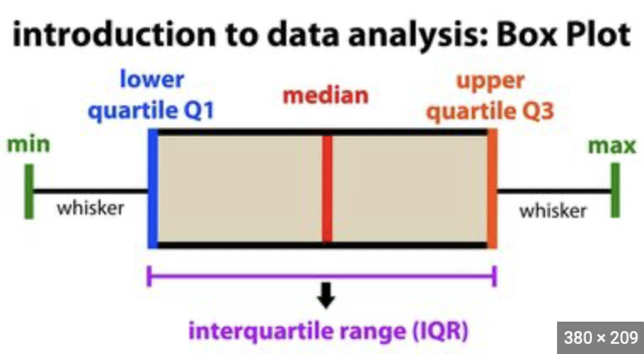
Pair Plot:
Pair plot visualizes given data to find the relationship between them
where the variables can be continuous or categorical. Plot pairwise
relationships in a data-set.
Box Plot :
A box plot is a graph that displays information from a five-number
summary that includes one of the central tendency measures.
It does not clearly depict the distribution as a stem and leaf plot
or histogram does. However, its primary function is to determine
whether a distribution is skewed and whether any potential outliers
—abnormal observations—are present in the data collection.

Slide 17
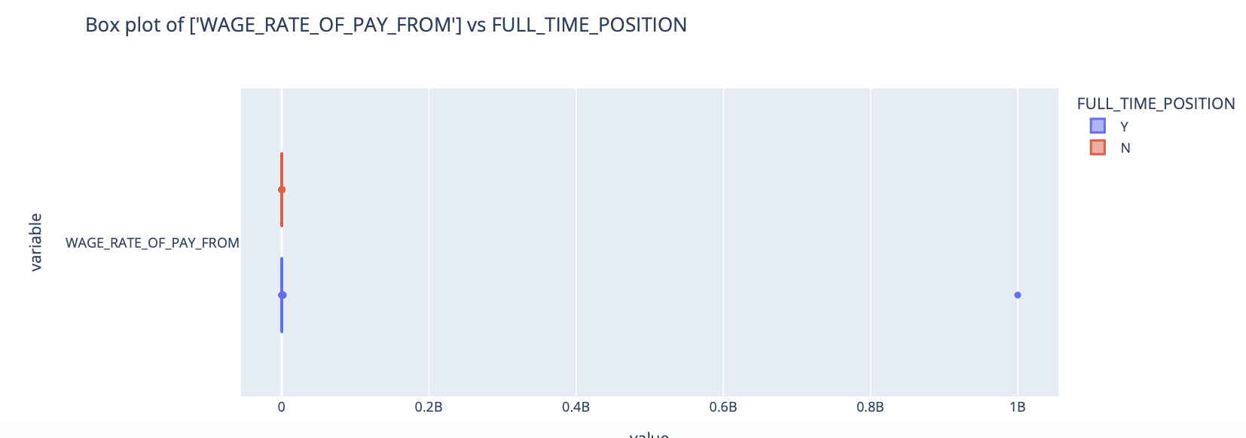
Box plot:

Slide 18
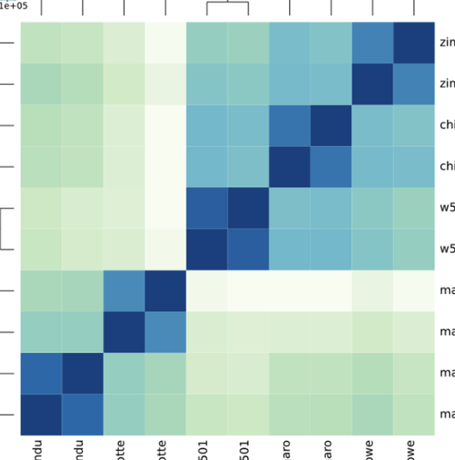
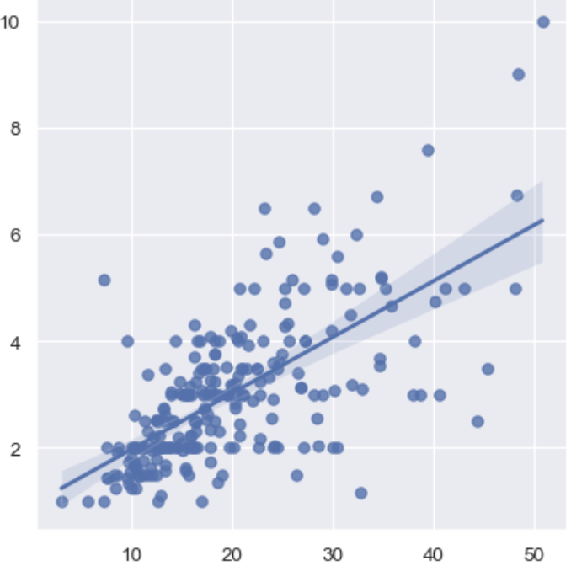
Heatmap:
A heatmap (aka heat map) depicts values for a main variable of interest across
two axis variables as a grid of colored squares. The axis variables are divided into
ranges like a bar chart or histogram, and each cell’s color indicates the value of
the main variable in the corresponding cell range.
Regression Plot :
Regression plots as the name suggests creates a regression line
between 2 parameters and helps to visualize their linear relationships.

Slide 19
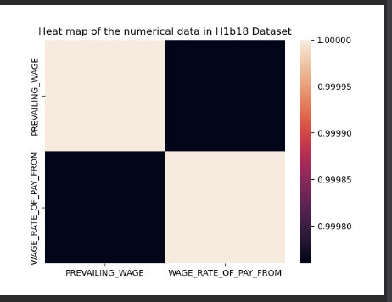
HeatMap Plot:

Slide 20
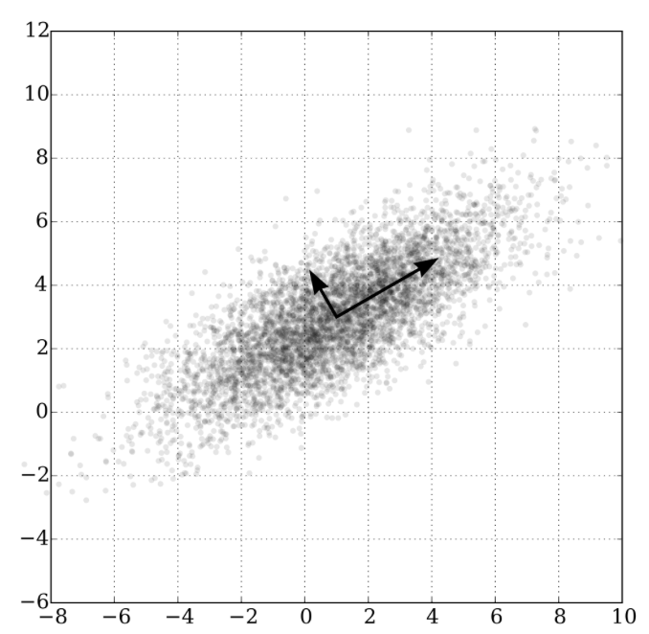
PCA: Principal Component Analysis
Principal component analysis, or PCA, is a statistical procedure that allows
you to summarize the information content in large data tables by means of
a smaller set of “summary indices” that can be more easily visualized and
analyzed.
HOW DO YOU DO A PRINCIPAL COMPONENT ANALYSIS?
Standardize the range of continuous initial variables
Compute the covariance matrix to identify correlations
Compute the eigenvectors and eigenvalues of the covariance matrix to identify the principal components
Create a feature vector to decide which principal components to keep
Recast the data along the principal component's axes

Slide 21
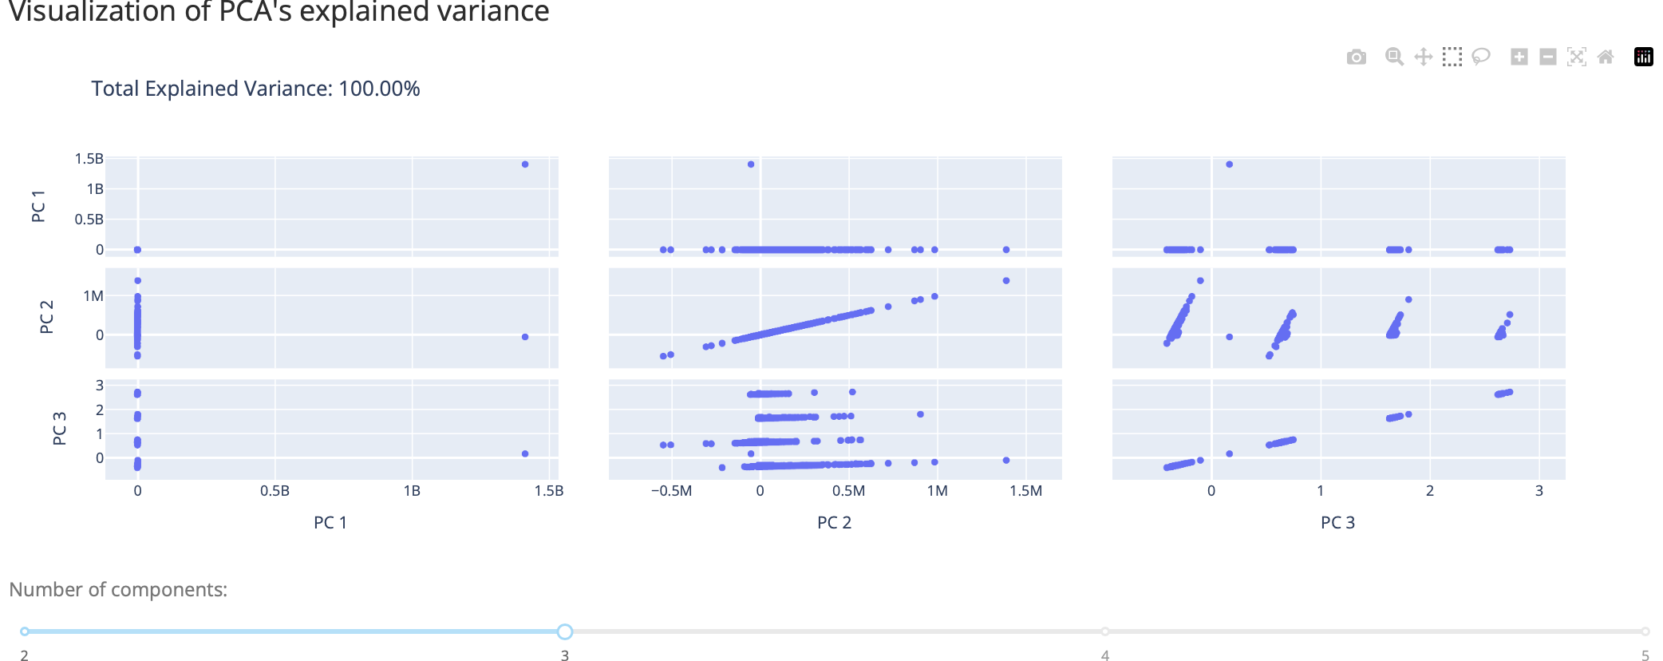
PCA Analysis:

Slide 22
` Summary and conclusion
After learning basic functionality of the graphs, we are able to plot the graph and able to give insights about the
Dataset used (H1b18.csv). By comparing the wages for non data science jobs and data science jobs, It appears that
there is not a massive difference in the median and mean wage of data science jobs. Both the median appear to
be between 60,000 and 80,000. However, the non data science jobs tend to have a larger interquartile range which
could be explained by the diverse jobs that other H-1B applicants had.
As an aspiring data scientist, I thought that it would be interesting to explore the H-1B application process
for data scientist. There were 63,503 applications for data scientists.
We can observe that the top three companies are all from the technology sector. In fact, most of the
companies that apply for H-1B visas are from the technology sector. In future we, will try to apply
statistical models to predict the acceptance rate of H1b visa.

Slide 23
References:
https://statistics.laerd.com/statistical-guides/understanding-histograms.php
https://www.tibco.com/reference-center/what-is-a-pie-chart
https://builtin.com/data-science/step-step-explanation-principal-component-analysis

Slide 24
Thank you

